Slide 1

IoT REMOTE MONITORING AND CONTROL SYSTEM FOR SMART AGRICULTURE USING PYTHON PROGRAMMING
PROJECT GUIDE :
Dr .MADHU SUNDAR
Assist Prof. (SG), Dept. of Industrial Eng.,
Institute of Mechanical Eng.,
SSE, SIMATS
TEAM :
K.KISHORE-192211912
P.K.GOKULAVASAN-192211892
A.MANIDEEP-192210054
SSE, SIMATS

Slide 2
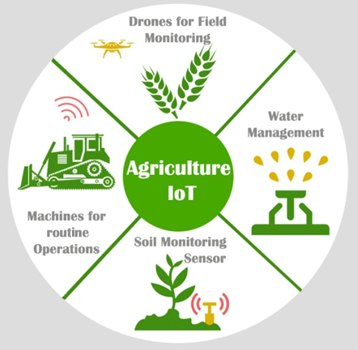
ABSTRACT:
Overview: This project focuses on developing an internet of things (IoT) based remote monitoring and control system tailored for smart agriculture practices.
Problem statement: Modern agriculture demands efficient resource management and real-time monitoring to enhance productivity. Traditional methods lack scalability and real-time data access, prompting the need for IoT solutions.
Solution approach: leveraging python programming language and IoT technologies, this project aims to design a comprehensive system that enables farmers to remotely monitor and control various aspects of their agricultural operations.

Slide 3
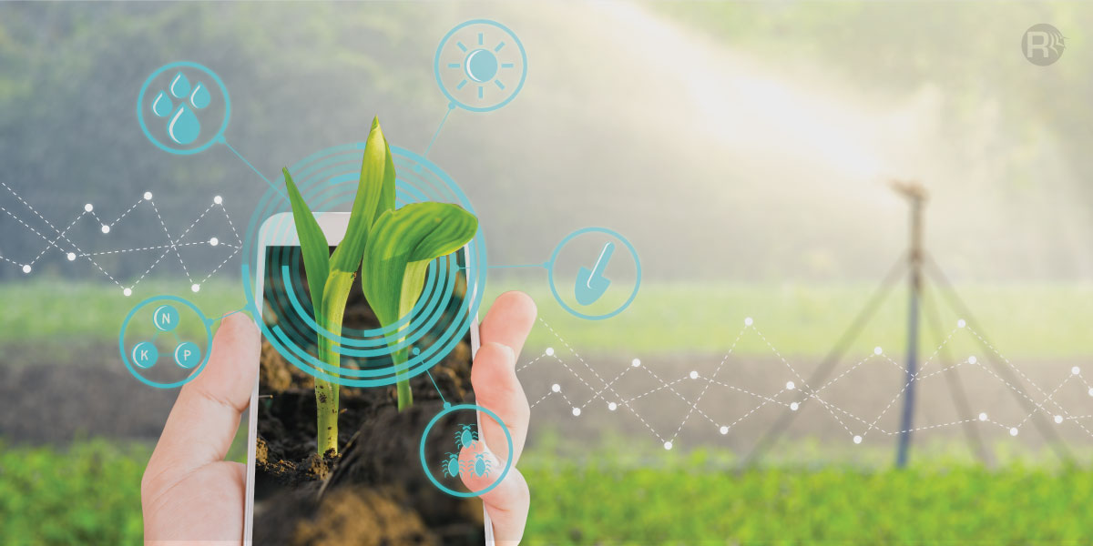
INTRODUCTION:
Introduction to the increasing importance of technology in agriculture.
Brief overview of the internet of things (IoT) concept.
The significance of remote monitoring and control systems in modern agriculture.
Introduction to python programming language as a versatile tool for IoT applications.
Importance of real-time monitoring and control for optimizing resource usage and enhancing crop yields.

Slide 4
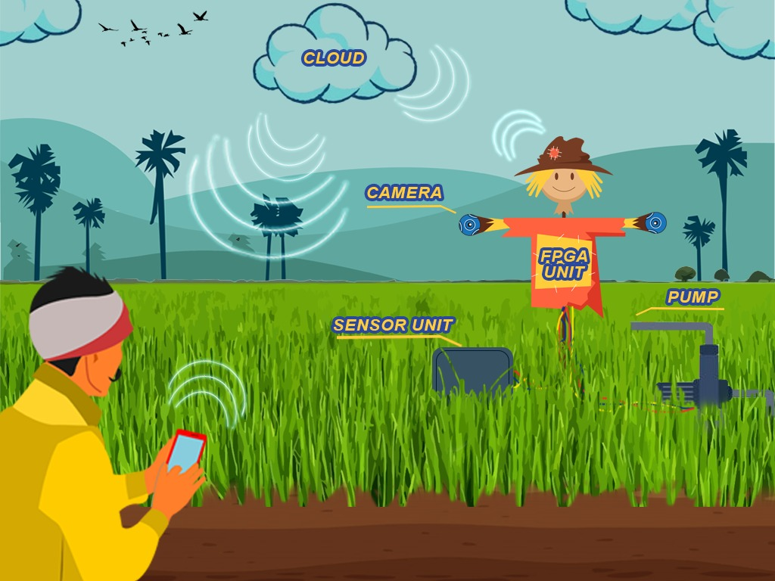
OBJECTIVES:
Develop an IoT-based system for remote monitoring and control in smart agriculture.
Implement python programming for system development and management.
Integrate sensors to collect real-time data on soil moisture, temperature, and humidity.
Utilize data analytics to generate insights on crop health and environmental conditions.
Enable remote control functionality for irrigation systems and nutrient supply.

Slide 5
Existing System:
Review of existing remote monitoring and control systems in agriculture.
Analysis of traditional agricultural practices and their limitations in terms of efficiency and productivity.
Overview of IoT applications in agriculture, focusing on remote sensing, data analytics, and automation.
Examination of research papers, articles, and patents related to IoT-based solutions for smart agriculture.
Comparison of different IoT platforms and technologies used in agricultural monitoring and control systems.

Slide 6
Research Gap:
Despite significant advancements in IoT-based solutions for agriculture, there remains a gap in the development of comprehensive, user-friendly systems specifically tailored for small to medium-sized farms.
Many existing systems focus on large-scale commercial agriculture, neglecting the needs and constraints of smaller farms.
Limited research has been conducted on the integration of IoT technologies with traditional farming practices in developing regions, where access to resources and technology infrastructure may be limited.
There is a lack of standardized protocols and frameworks for interoperability among different IoT devices and platforms used in agricultural applications.

Slide 7
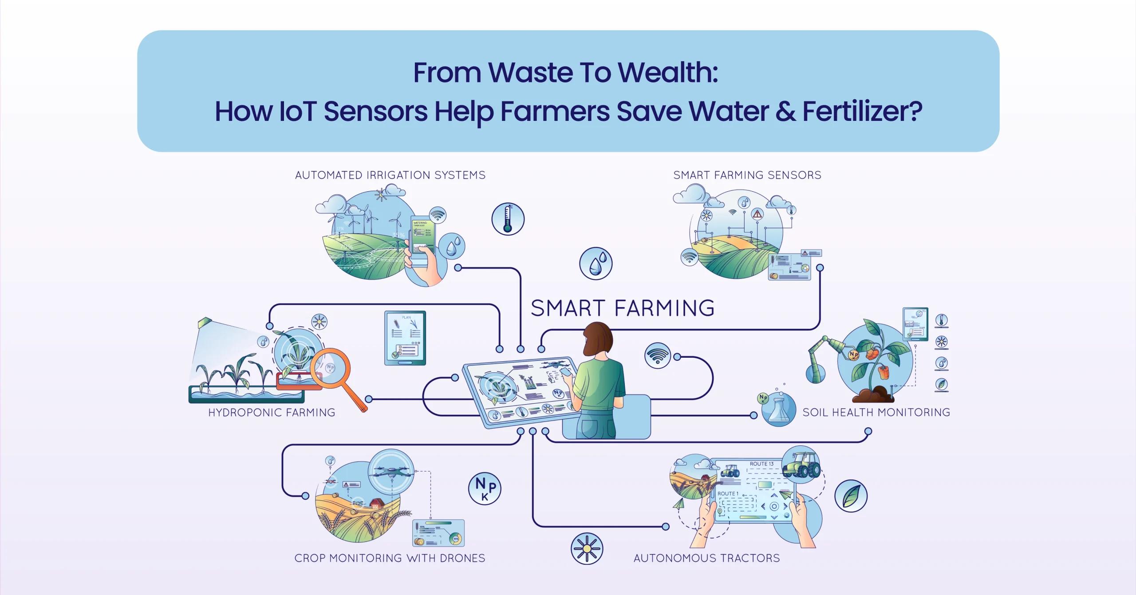
Proposed Model

Slide 8
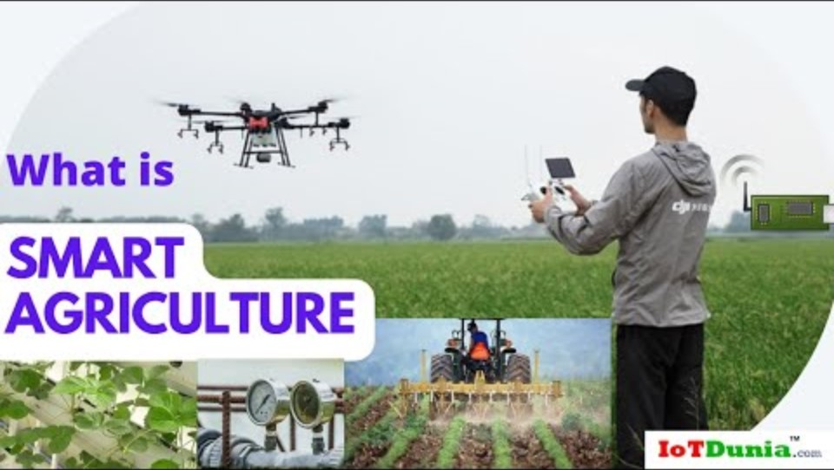

Slide 9
Method explanation
Data collection: sensors deployed across the agricultural field collect data on various parameters such as temperature, humidity, soil moisture, etc.
Data transmission: microcontrollers receive data from sensors and transmit it to the central hub using mqtt or other suitable communication protocols.
Data processing and analysis: the central hub receives the data, processes it, and performs analysis to derive insights into the agricultural conditions.
Decision making: based on the analyzed data, the system makes decisions regarding control actions such as irrigation, fertilization, pest control, etc.

Slide 10
Implementation
Hardware setup: deploy sensors and microcontrollers across the agricultural field. Connect sensors to microcontrollers.
Software development: develop firmware for microcontrollers to collect data from sensors and transmit it to the central hub. Develop the central hub software for data processing, analysis, decision making, and communication with actuators.
Cloud setup: set up cloud infrastructure if needed for storage, processing, and visualization of data.
User interface development: develop a web or mobile application for users to interact with the system.
Integration and testing: integrate all components together and conduct rigorous testing to ensure the system functions reliably.

Slide 11
Results and discussion
Improved crop yield and quality due to optimized control actions based on real-time data.
Reduction in water usage through precise irrigation scheduling.
Enhanced pest management through early detection and targeted interventions.
Increased efficiency and productivity of agricultural operations.
Cost savings and environmental benefits.

Slide 12
Conclusion
The iot remote monitoring and control system presented in this study offer significant advantages for modern agriculture. By leveraging advanced technologies such as iot, cloud computing, and data analytics, farmers can make informed decisions, optimize resource usage, and maximize crop yields. The system provides a scalable and adaptable solution for various agricultural settings, contributing to sustainable farming practices and food security.

Slide 13
References
[1] smith, J., & Jones, A. (Year). Title of the paper. Journal name, volume(issue), page range.
[2] johnson, b., Et al. (Year). Title of the book. Publisher.
[3] official documentation of mqtt protocol: https://mqtt.Org/documentation

